Slide 1
Prism
Created by: Juan Garza, Eduardo, Jonathan, Samuel

Slide 2
Table of Contents
Overview
Plan
Process
Player
UI Bars & Icons
Dungeon
Enemies
Boss
Quality of life

Slide 3
Overview
Prism is a 2D dungeon crawler game, which is a type of scenario in a fantasy role-playing games in which heroes navigate labyrinth environment, battling various monsters and collect any loot!
Prism is a mixture of classic and new, implementing a new (COLOR) system, where the player must rotate colors in order to progress in the game!
This project was developed using unity and using C# as its language.

Slide 4
Premise
In a colorful Kingdom a present was delivered to the King from the dungeons. Unknowing of who the sender was the King opened the present only to reveal a small prism. The prism absorbed all the colors of the kingdom and traveled back to the dungeons leaving the kingdom lifeless.
A hermit living in the outskirts of the kingdom was not affected by the prism. As he drew near the king sought him out and asked him to retrieve the color back to their kingdom and he would be rewarded handsomely.
With nothing to lose he agreed and the King granted him a crest that allowed him to manipulate color, and so his journey begins in the prism’s dungeon

Slide 5
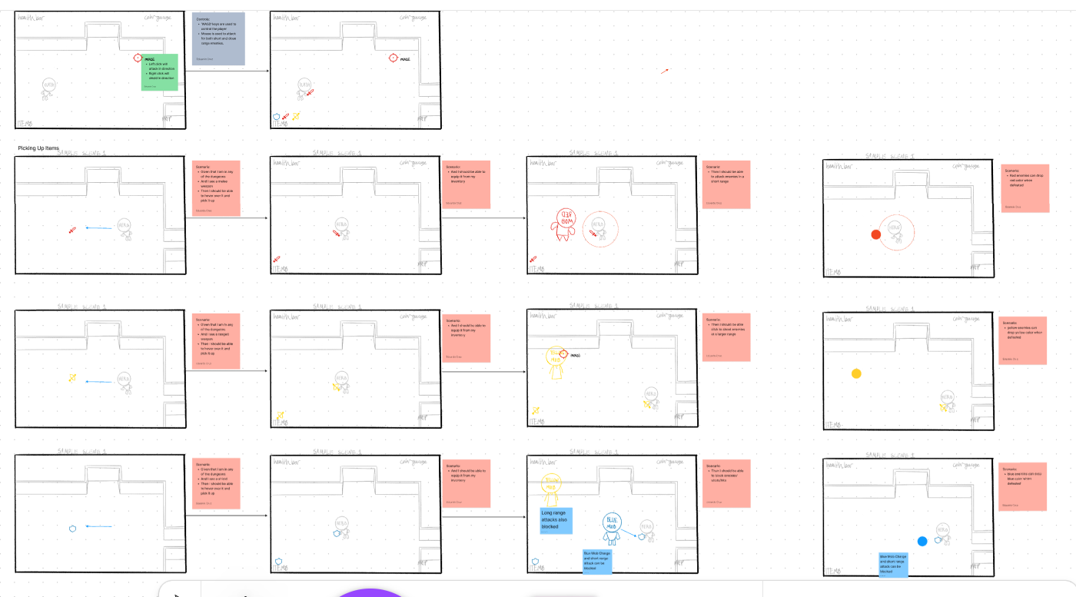
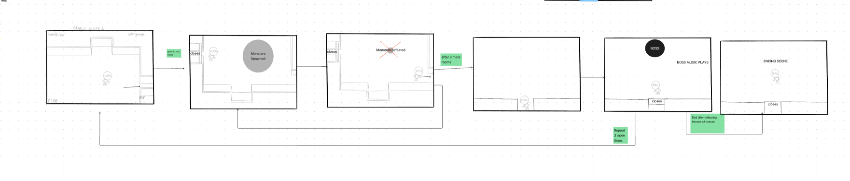
Planning User Stories: Figma
Figma creates user stories that included the cause and effect of some common player interactions.
We used it to decide the character models, dungeon iteration, boss attacks, and enemy attacks.

Slide 6
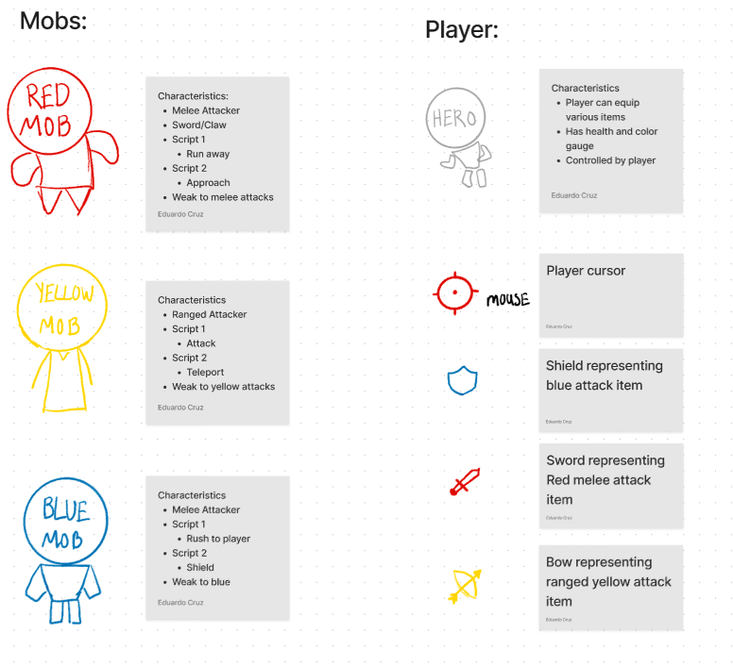
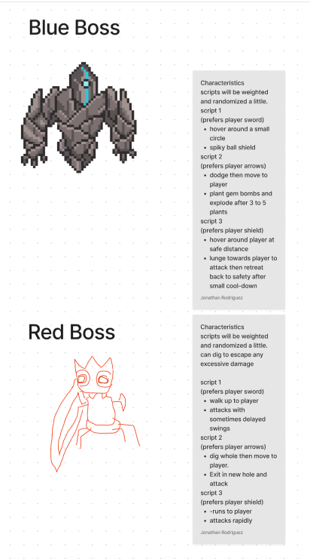
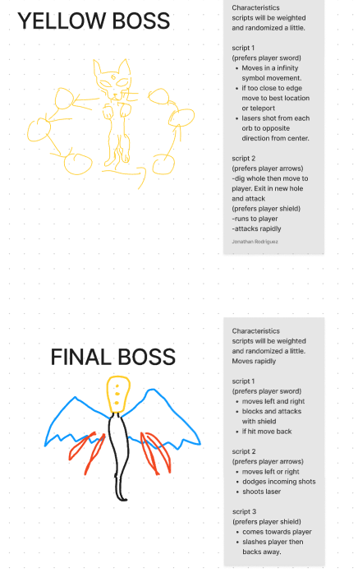
Planning User Stories: Figma Models

Slide 7
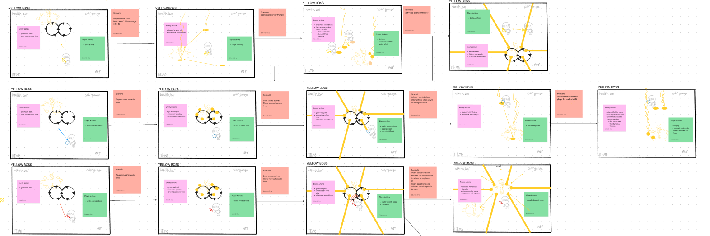
Planning User Stories: Boss

Slide 8
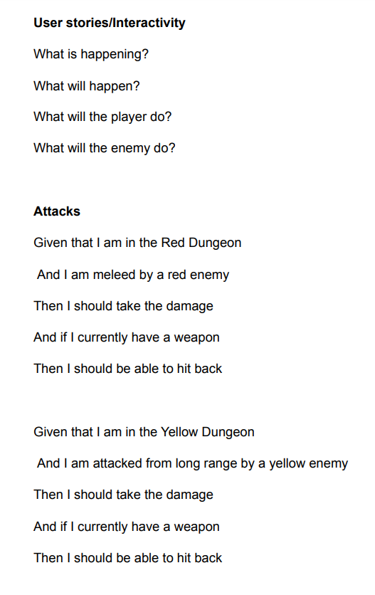
Planning User Stories: Word
Throughout this process our team was brainstorming ideas on how we would like our game design and mechanics to be like.
This process was done in collaboration with the Figma designs to make sure every detail was marked down.
A Google Doc was made describing events that would occur between the player, enemy, boss, and user
This included attacking, defending, damage, game settings, item pickups, etc.

Slide 9
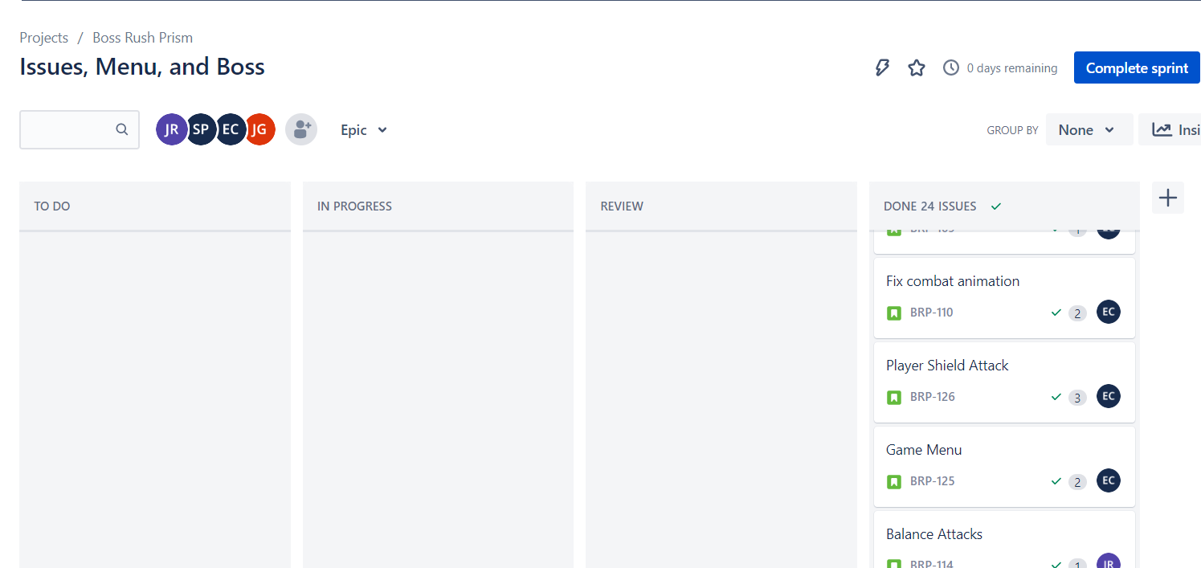
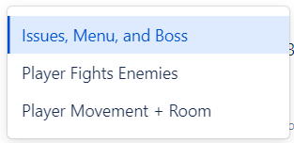
Planning Tasks: Jira
Jira managed our work by working in iterations and assigning ourselves tasks.
Player Movement + Rooms
For player movement, UI, health, and color system.
Player Fights Enemies (Demo)
Red and Yellow enemy’s attacks, movement, health, and procedurally generated map.
Issues, Menu, and Boss (Final)
Demo issues fixed, Redirect to scenes, boss movement, attacks, and controller, and game over screen.

Slide 10
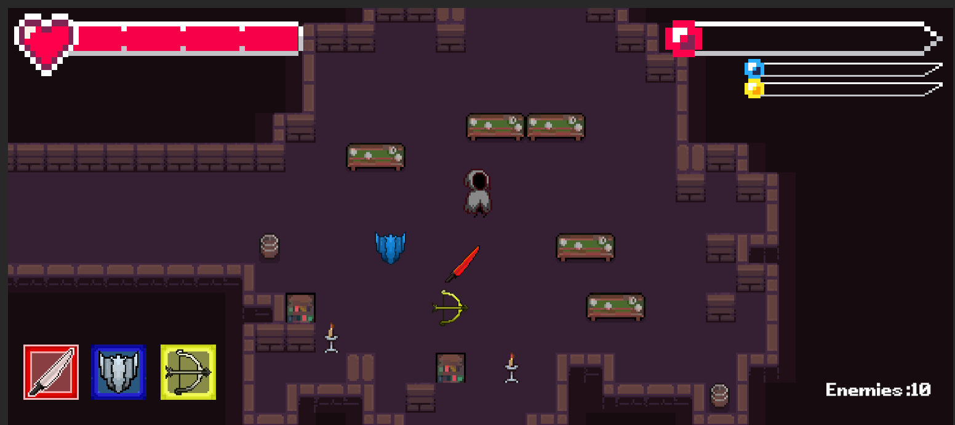
UI Bars & Icons
Health-bar
Slider based on health. Updates heart to full, half, empty, or hit.
Color-bars & Weapon Icons
Swaps between colors and its amount depending on active weapon. Array is used to swap images for both.
Enemy Count
Enemies increase counter in script. Triggers boss scene when all enemies are defeated.

Slide 11
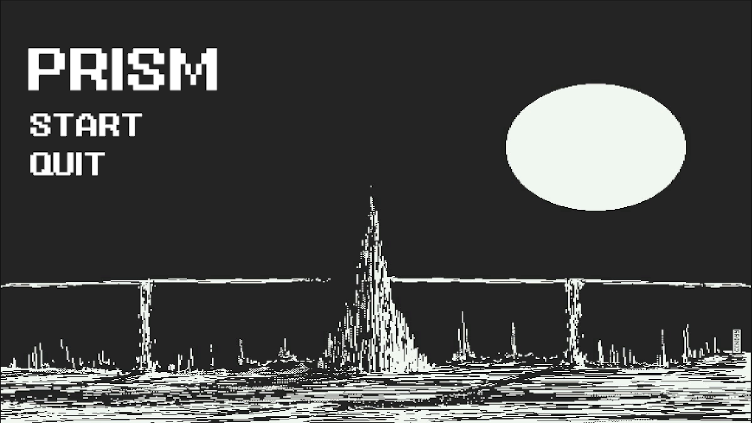
Title Screen
Simple title screen depicting the colorless Kingdom.
Has two buttons to either quit the game or start the game.
Music to create scene and vibe for the game.

Slide 12
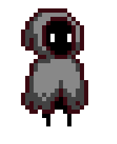
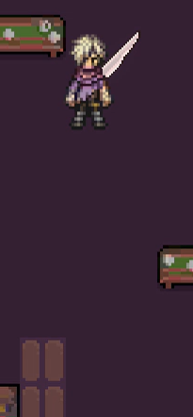
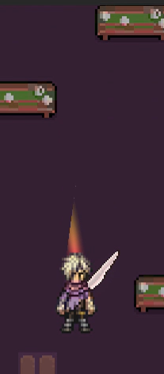
Meet the HERO
During the initial phase of the project the HERO sprite was completely different as well as its characteristics
Direction facing wasn't obvious
Not free to use sprite
Attacks were not obvious
New Sprite was then made to distinguish the players actions and direction facing.

Slide 13
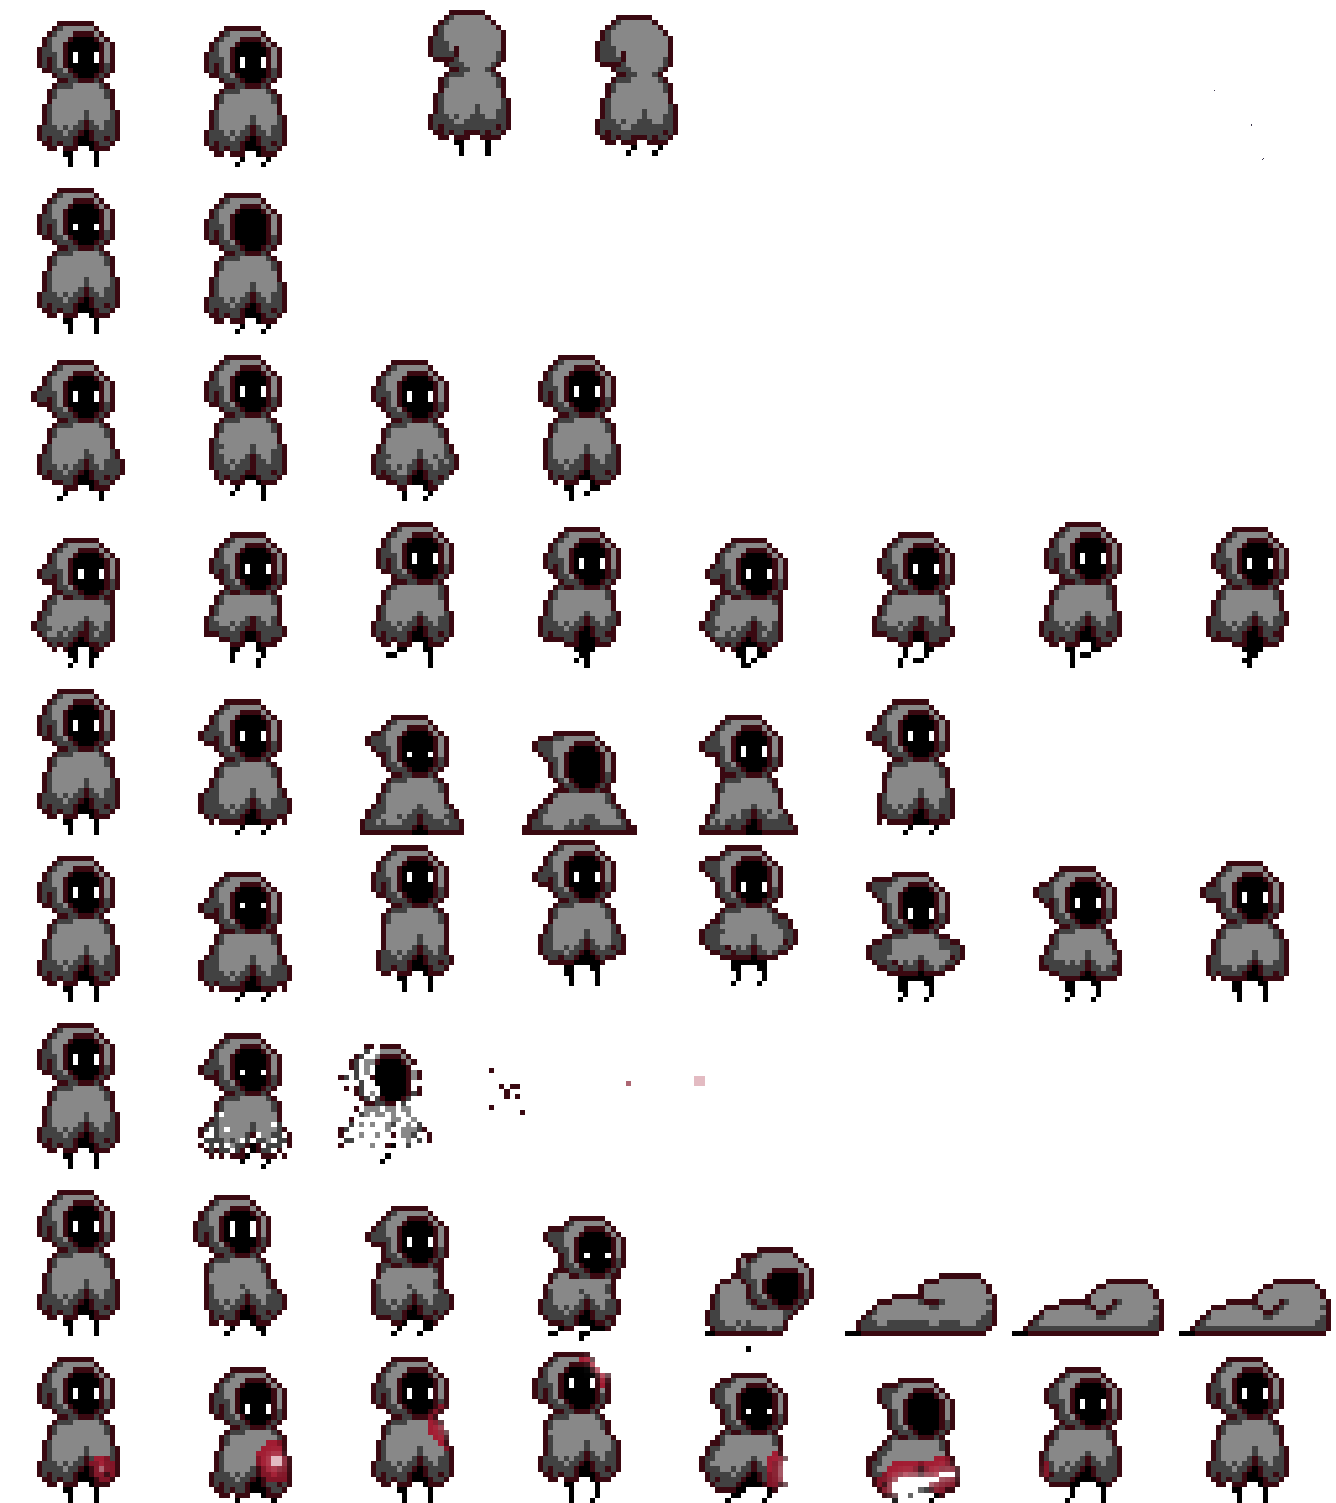



Controls
WASD/ SPACEBAR
L CLICK
L CLICK/ L+R CLICK
L CLICK
Switch between weapons using 1 2 3

Slide 14
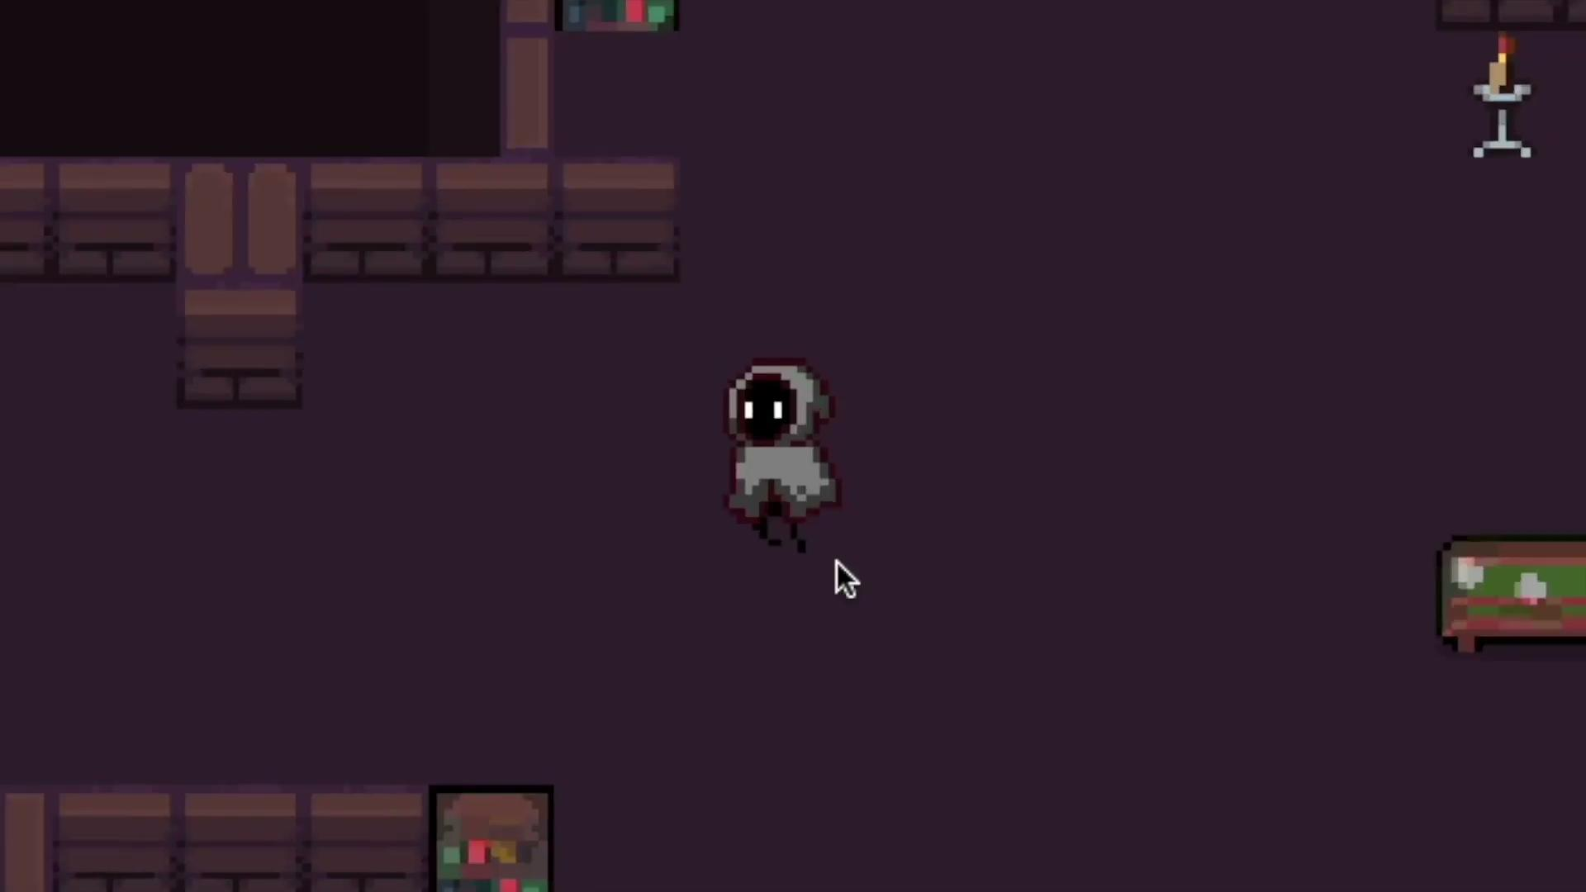
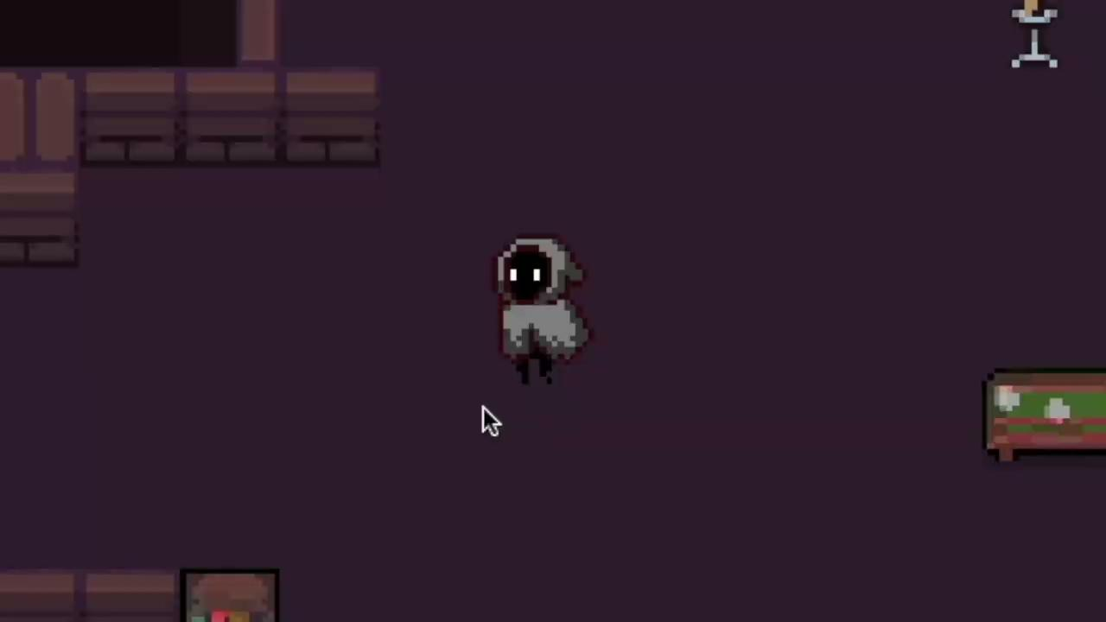
Player Movement
Using WASD you are able to control the movement of the HERO and with SPACEBAR you are able to dash
The last direction you were moving in is saved to keep track of the direction of the ranged attack
Changes:
New Animations
Character Model Flips to keep track of last direction faced

Slide 15
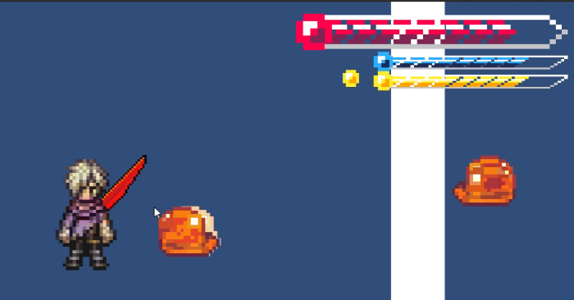
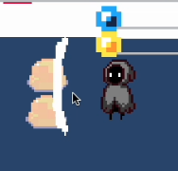
Melee Attack
With Melee Attack (RED) Selected you are able to Left Click to attack in the direction you are facing/moving also Knocking back enemies
RED color fills up the gauge for the red attack. This causes red enemies to take more damage.
Careful every swing decreases the amount of red in the gauge
Changes:
Animation was changed to address suggestions from showcase
Attack range has increased
Ability to attack multiple enemies
Fixed error when P;ayer Fliped

Slide 16
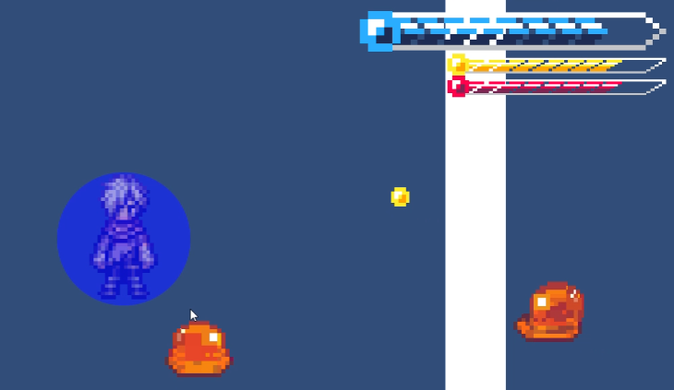
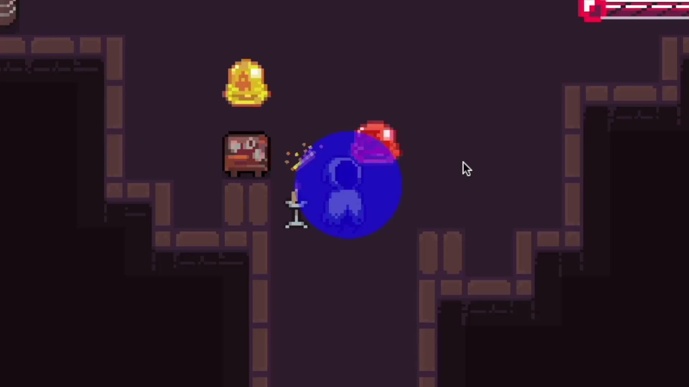
Shield Attack
With Shield Attack (BLUE) Left click to simply block damage. Left and Right click to knockback enemies and deal damage as well as block any incoming damage.
BLUE color fills up the shield gauge. Can only attack if there is blue, if not only serves as a shield
Changes:
Can Now Attack multiple enemies
Attack/block range increased
Has delay to stop spamming enemy

Slide 17
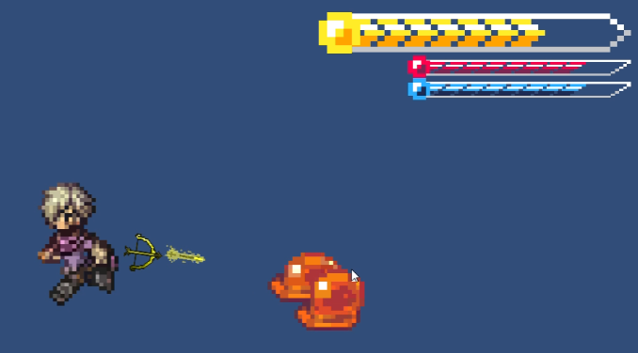
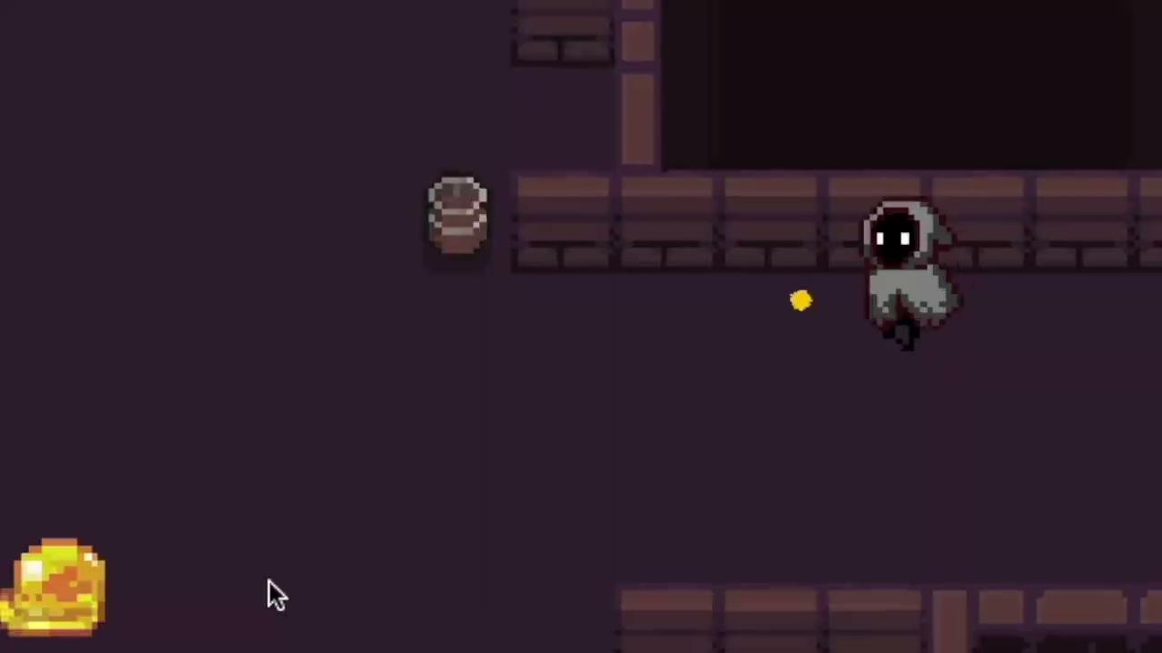
Range Attack
With Range Attack (YELLOW) Left click to shoot in the direction of the mouse
YELLOW Fills up the range attack gauge, as you shoot it decreases.
Changes:
Changed the visual assets to be more noticeable
Fixed rotation error when character is flipped

Slide 18
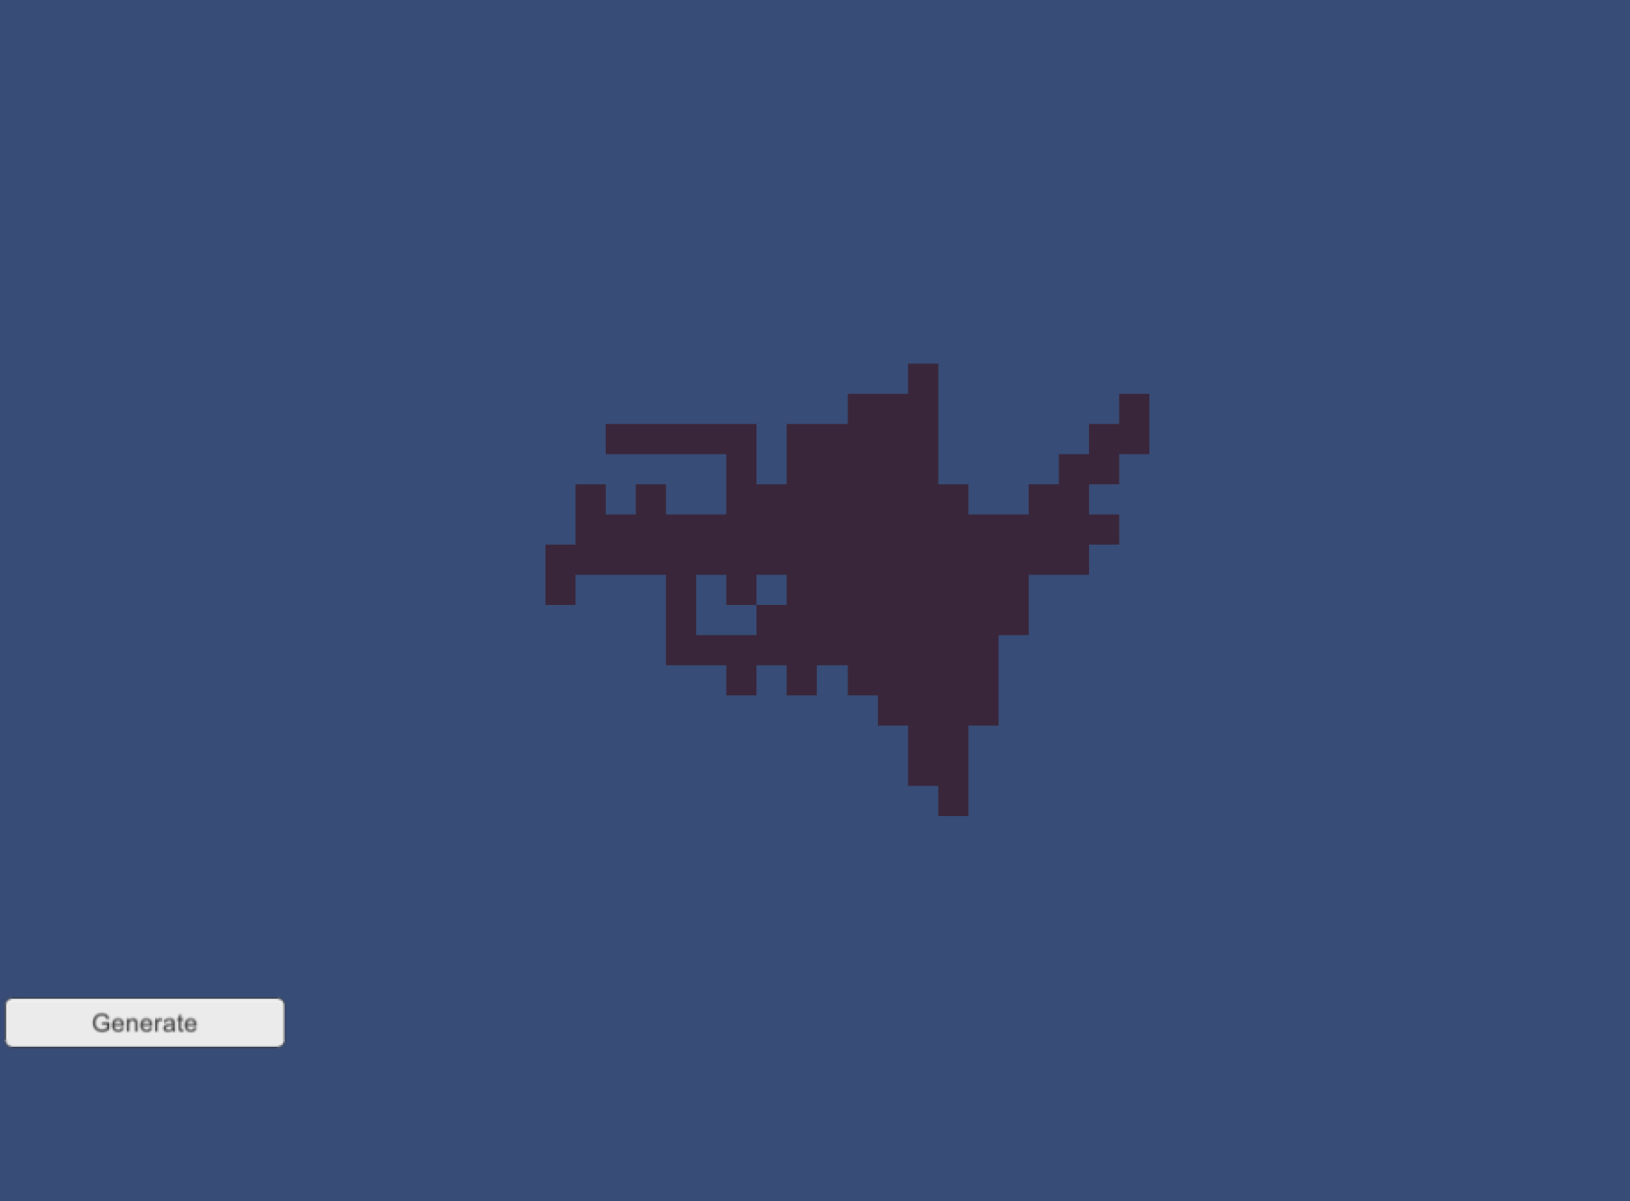
Dungeon
Map was created with it being procedurally generated and as organic looking as possible.
This was achieved using a series of algorithms like a random walk generator, a corridor creation algorithm and a prefab item placement generators.
Earliest iteration

Slide 19

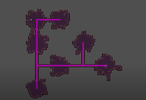
Corridor
The corridors were added soon after the first dungeon generator was created.
A Corridor first algorithm was implemented to keep track of the tile in the middle of each room to ensure that each dungeon would have one.
This was also done to ensure that prefabs did not get in the way of the corridor exists.
Earliest iteration
Corridor tracking system

Slide 20
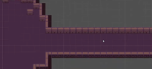
Corridor cont.
The corridor was later expanded from a 1 by 1 tile system to a 3 by 3.
This was done to ensure that the player would not get suck while traversing.
The algorithm keeps track of itself and stores data for the usage of the prefab placements.
Earliest iteration
3 by 3

Slide 21
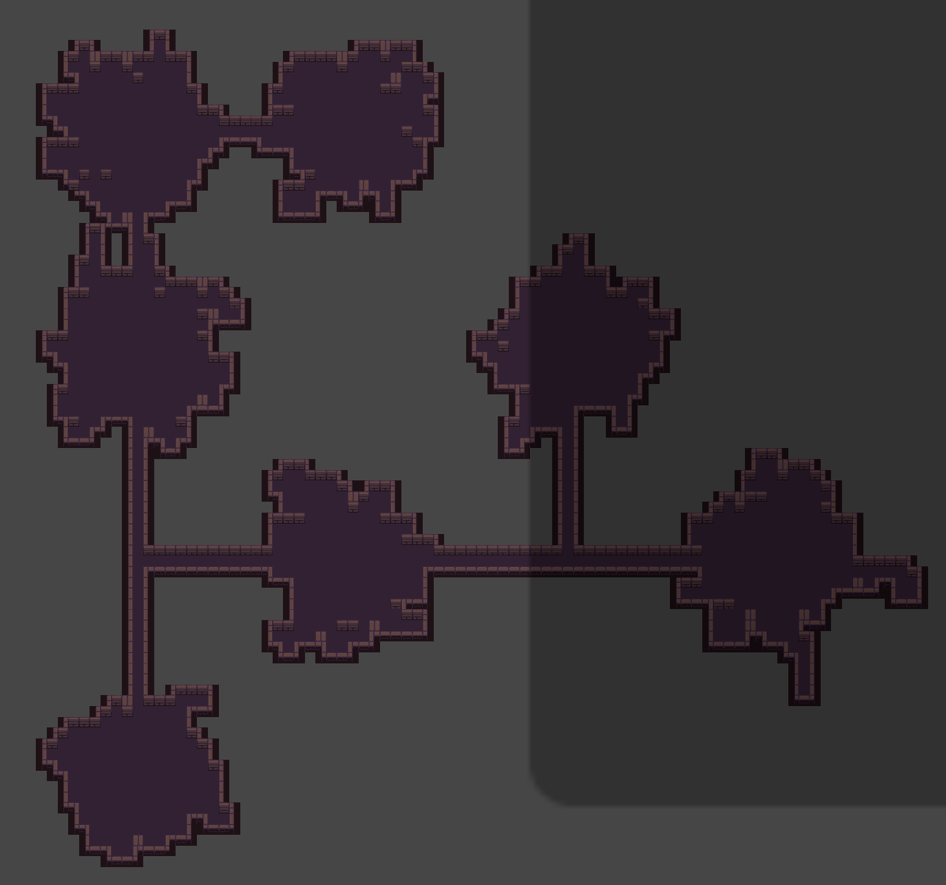
Dungeon with corridors
The dungeon’s corridor system was a narrow, so we decided to expanded by 3 tiles in width instead of the initial 1.
The dungeon algorithms were also modified to random content to it like crates and tables to ether aid or hinder the player in its quest.
A high level system was established to create a hierarchy of rooms to where the player(along with some helpful items) , and enemies will spawn.
latest iteration

Slide 22
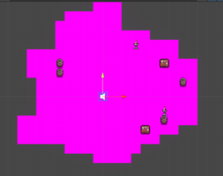
Prefabs
Procedurally placed prefabs were implemented to the game dungeon.
We first tested this in our first room, we saw that the items were placed correctly.
We for now have a lo-level room system with just dungeons.
Prefabs are placed at random all over the dungeons.
Early iteration

Slide 23
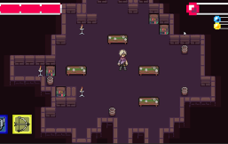
Prefabs cont.
To avoid prefabs on getting in the way of the corridors we implemented an algorithm along with the corridor algorithm to ensure that the prefabs would not get in the way of the corridors.
The algorithm keeps track of the corridor itself and up to the middle of each dungeon.
This was done to make sure enemies nor items would prevent the player from progressing.
Iteration 2
Corridor tracking

Slide 24
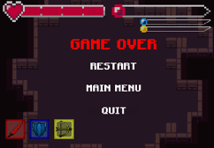
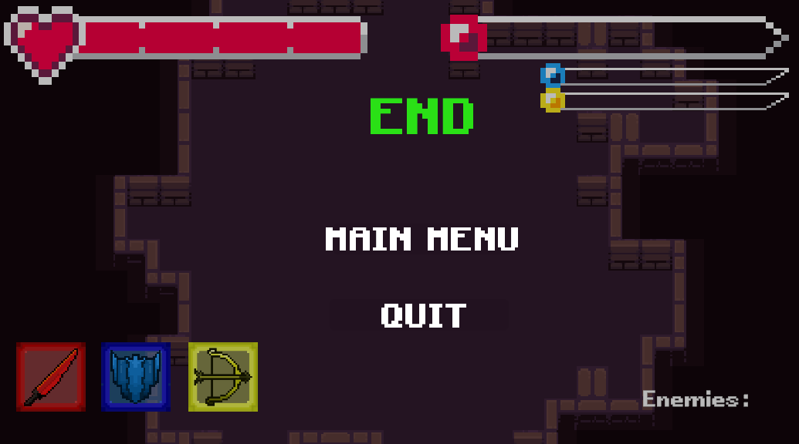
Game Over & End
A simple game over screen was implemented to ensure the three functions helped the player get to where they needed to get after they were slayed. As shown the player was three options to use from
The player is given a restart, main menu, and a quit options respectively.
Everything in the game is also stopped including players actions and enemy’s actions.
End is made using the same prefab as gameover without the restart. This happens when boss is defeated.

Slide 25
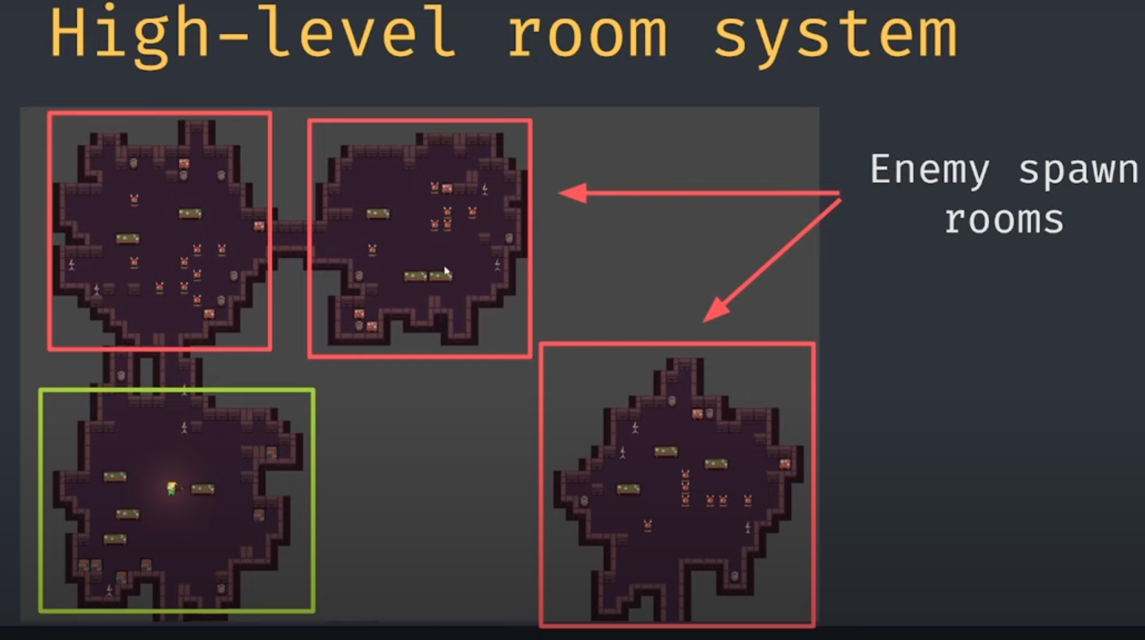
High Level System
It was created to work with the current game mechanics that we have.
It was created to ensure that the player would not spawn in unfair places.
The system helped in the creation of the rest of the game design.
Enemy rooms and player rooms were created but the boss room was a different scene.

Slide 26
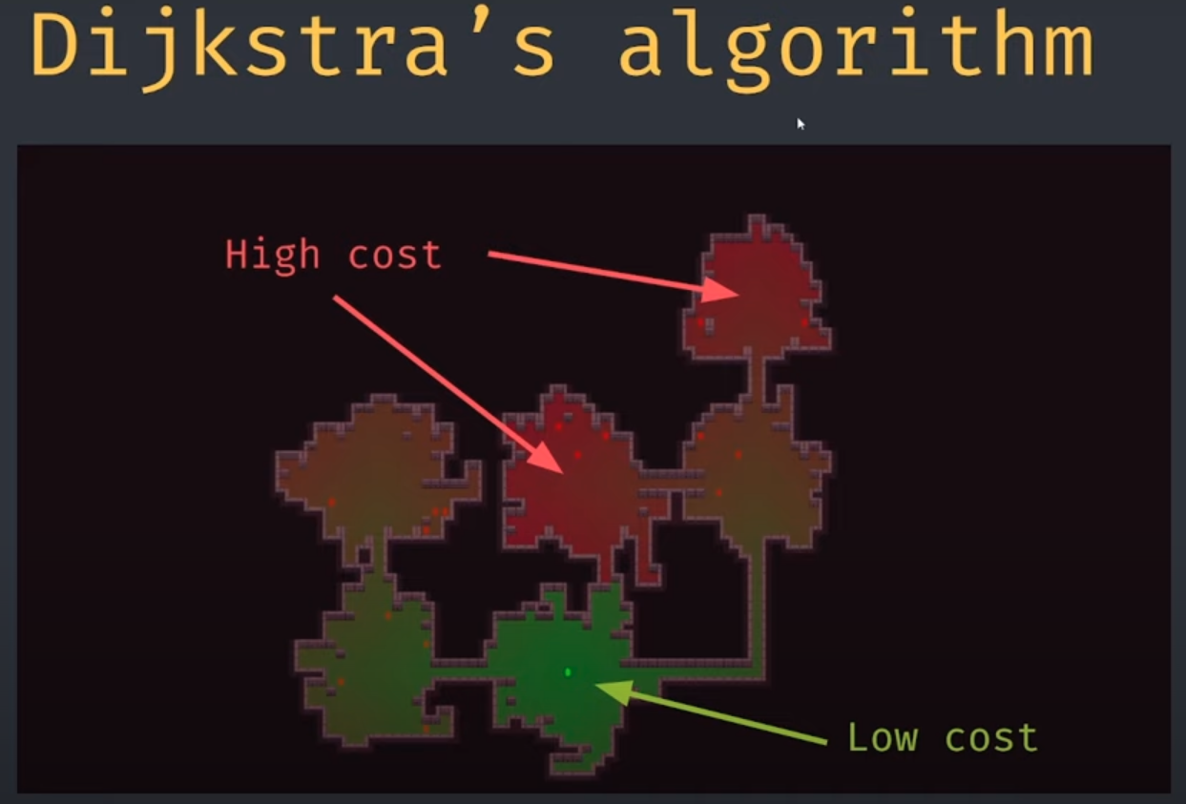
High Level System cont.
Dijisktra’s Algorithm was used to calculate the cost of movement to each tile from the startposition.
Green tiles are at low cost as they are closer to the starting position and as the cost increases we are farther from it.
As the cost increase different placements of enemies or weapons were placed.

Slide 27
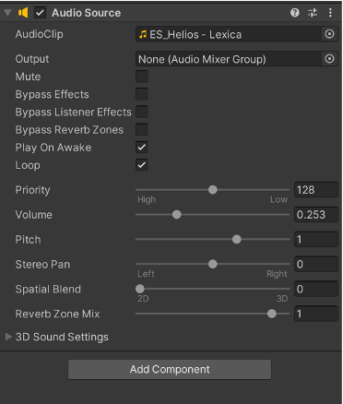
Music
We wanted to create an mysterious but welcoming environment for the player as they play the game.
We went with a mix of futuristic sci-fi music as it would best fit the game we are creating.
Three pieces were choose for the main menu, the dungeon itself, and the boss fight.
Implementation was done using an empty object and using Unity’s audio source.

Slide 28
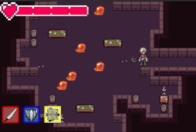
Enemies Placement
Using the same principal for the random prefab placement, we were able to implement that for placing random enemies.

Slide 29
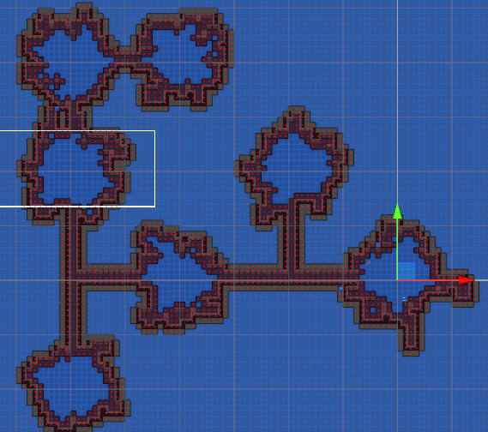
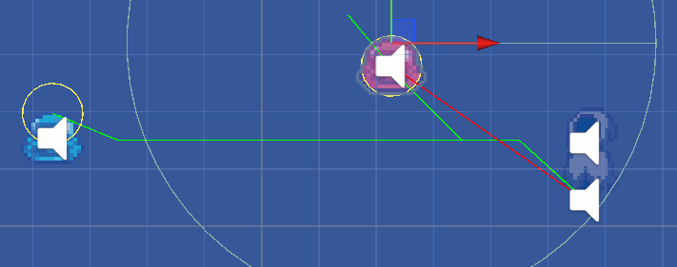
Pathfinding
Enemies have been fitted with an Astar algorithm that looks for the shortest path in any given web.
The map to the right shows the given webs after Astar has found colliders.
Each enemy is then able to find the shortest path to the player within their allotted web.

Slide 30
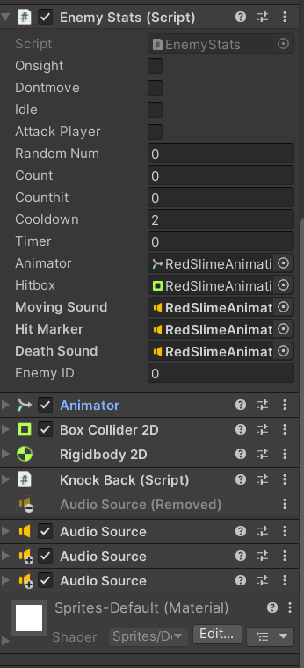
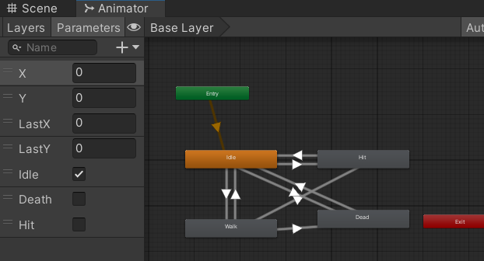
Slime Enemies Same Features
Animations include WASD and idle movement, hit, and death using an animator.
Enemy has sound when moving, dead, or hit.
Red and blue slime share an A* pathfinding movement. Collider is used for awareness with raycasts to detect if they can attack the player directly.
Unique ID for each enemy color.

Slide 31
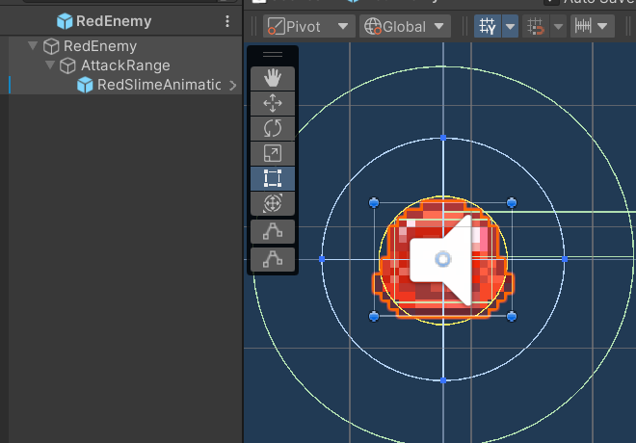
Enemies Red
Attack remembers location, moves towards player, then goes back to location.
Enemies have a knockback feature when hit.
Complications: movement, clipping through walls.

Slide 32
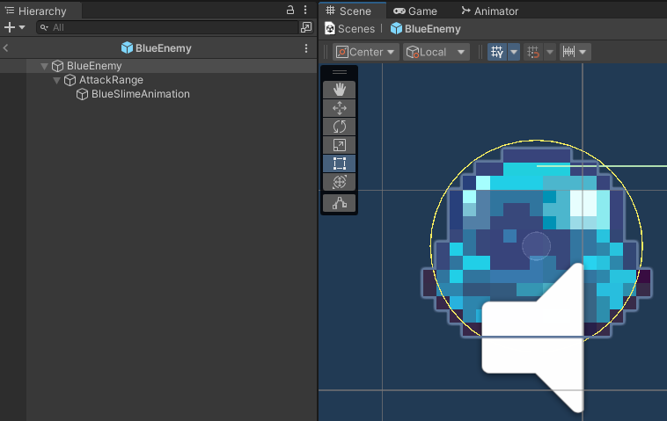
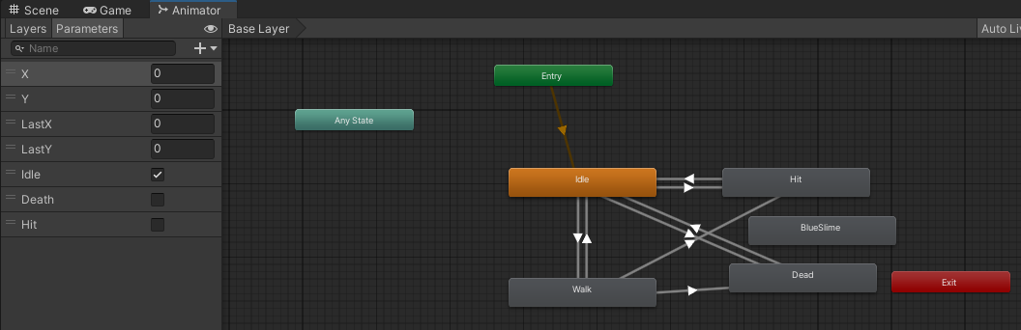
Enemies Blue
Blue enemies attack when it detects the player collider nearby, this enemy will leech on to the player and activate a timer.
This action will cause it to self destruct once it reaches 10 seconds. This timer is reset every time it detects the shield or when it no longer detects the player.
This enemy does have a different death animation since it self destructs.
Complications: attachment, detachment, player damage

Slide 33
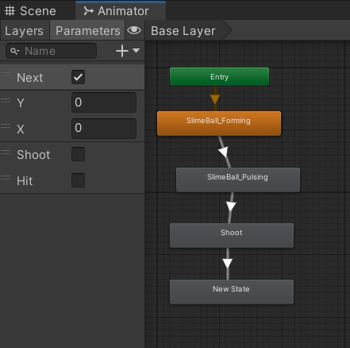
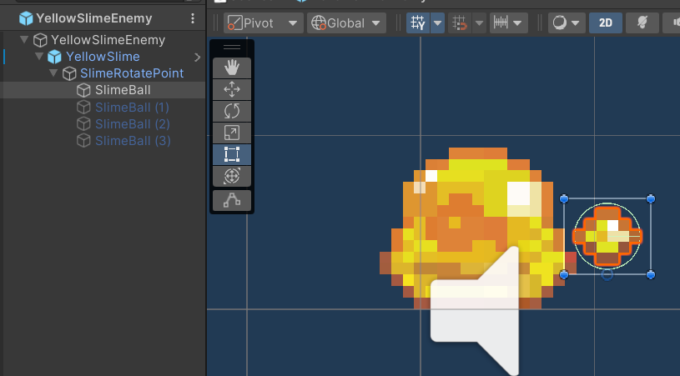
Enemies Yellow
Attacks by creating a ball of slime and shooting it at the player using raycast to detect if player is within range and in view.
Slimeball bullets charge up then shoots at player and explodes on player.
Complications: slimeball lost on player’s shield active/inactive. Once the enemy is gone destroy the ball.

Slide 34
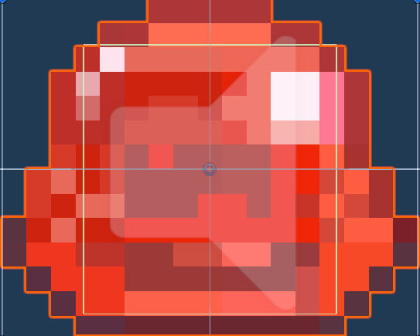
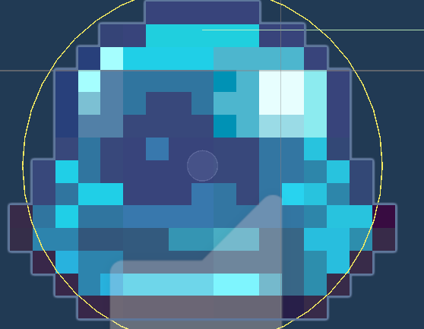
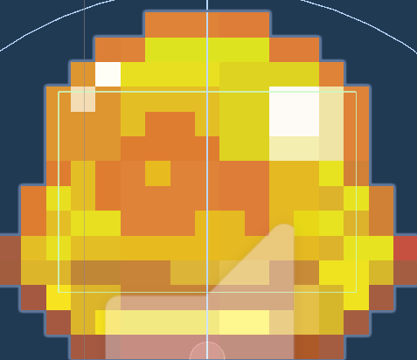


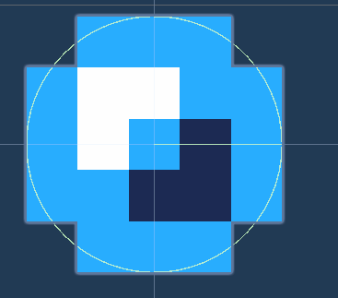
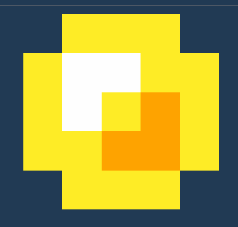
Enemies Drops
When enemy dies color drops are randomly generated between the energy of enemy’s color, heart, or nothing. The color dropped depends on the color of the enemy using an ID system given to each type of enemy.

Slide 35
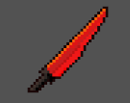


Items
Items can be picked up and fills the color meters and thus activating the correct color of the weapon by giving an ID to each item. Items get picked up using on trigger collider reacting to player. They are either sent back to a pool of its own kind or destroyed.
Items include sword, shield, bow, red color, blue color, yellow color, and health.
They all play a sound when collected.

Slide 36



AI Boss
Health System:
Destroy boss’ crystals until all 9 are destroyed (respawns 3).
Controller:
Health, distance, and active weapon it choosing which attack and movement to use. It also has a 20% chance of switching between attacks/movements.
Once an attack is stopped the movement starts and vice versa.
5 Animations:
Boss
Boss’ parent
Crystals
Lightning Attacks
Teleport
Sounds
Crystals
Boss Hit

Slide 37






AI Boss Movements
Teleport with lightning inside a square shaped map
Moves in a ∞ path. Uses raycasts for distance away from walls.

Slide 38



AI Boss Attacks
6 lightning attack targeting player. Unparent then goes to player, damages, then parents back.
6 laser beams traveling around boss. Sparks on crystals, shoots lasers, then turns off.

Slide 39
Sources
Dungeon creation: https://youtu.be/-QOCX6SVFsk
Prefab placements: https://youtu.be/t1a1QBcfRlM
Enemy placement: https://youtu.be/JOkOih1AKsQ
Wall placement collisions: https://youtu.be/-QOCX6SVFsk
Corridor expansion: https://youtu.be/jCVa4O4RksU
High level System: https://youtu.be/t1a1QBcfRlM
Game over Screen: https://youtu.be/pKFtyaAPzYo
Music: https://youtu.be/KOf3P5y19Bw
Transition: https://youtu.be/CE9VOZivb3I
Laser: https://youtu.be/S6eRVwAtfOM
Player Dash: https://youtu.be/Bf_5qIt9Gr8
Mouse Shoot: https://youtu.be/-bkmPm_Besk

Slide 40
Sources cont.
Ava Low - Into the Prism https://www.epidemicsound.com/track/JusvqlEULL/
Lexica – Helios https://www.epidemicsound.com/track/HLklhDSNTw/
Lupus Nocte – Astrophage https://www.epidemicsound.com/track/t40NyOP3s9/
Simple Player Movement: https://youtu.be/whzomFgjT50
Astar: https://www.youtube.com/watch?v=jvtFUfJ6CP8
Animations: https://www.youtube.com/watch?v=hkaysu1Z-N8
Knockback: https://www.youtube.com/watch?v=RXhTD8YZnY4

